Slide 1

Capstone Project - IPL Data Analysis
Group 2

Slide 2
Team Introduction
Sumanth Reddy Gajjala
Sachin Kashyap
Surya Narasimha Manikanta PavanKumar Akula Jaya
w0832574
w0816129
w0811656
Sai Venkata Krishna Reddy Boyapati
Akhil Inaganti
w0811914
w0813504

Slide 3
Agenda
Introduction
Problem Statement
Dataset and Data Preprocessing
Provide an overview of the project and its objectives.
Clearly define the key challenge or opportunity that the project aims to address.
Describe the data sources, collection process, and the steps taken to clean and prepare the data for analysis.
EDA
Machine learning model
Conduct an Exploratory Data Analysis to uncover insights and patterns within the dataset.
Develop and train a machine learning model to generate the desired insights and recommendations.

Slide 4

Introduction to Project
Our project is based on Cricket analysis in which we will analyze the player and team performance according to their past result in the matches and this analysis will be done on IPL matches data.

Slide 5
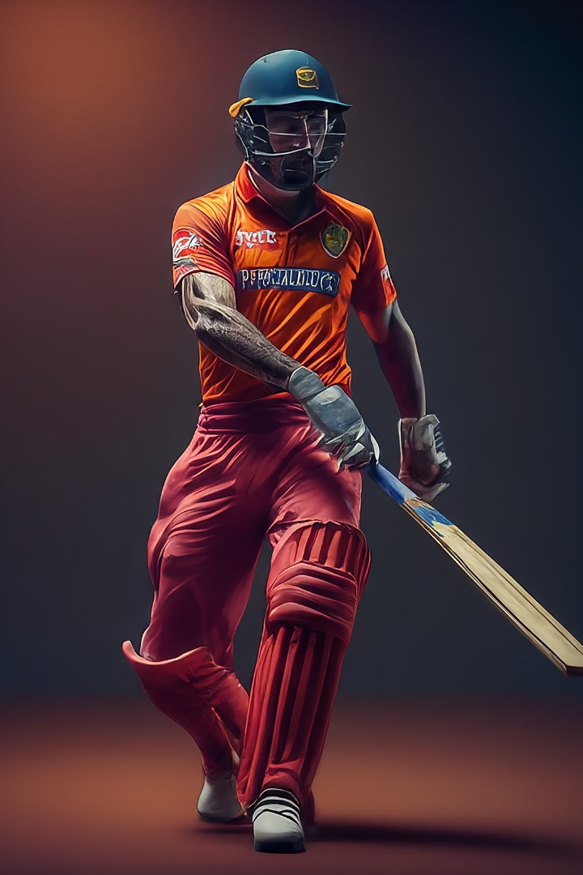
Problem Statement
In the world of cricket, brands seeking to optimize their marketing strategies face the challenge of identifying the most suitable IPL player for effective promotion. This project aims to leverage comprehensive data analysis of IPL match, social media, and player attributes to determine the optimal player profile that aligns with the brand's goals, values, and target audience. The objective is to provide actionable insights for brands to make informed decisions in selecting the ideal player for successful and impactful promotional campaigns.

Slide 6
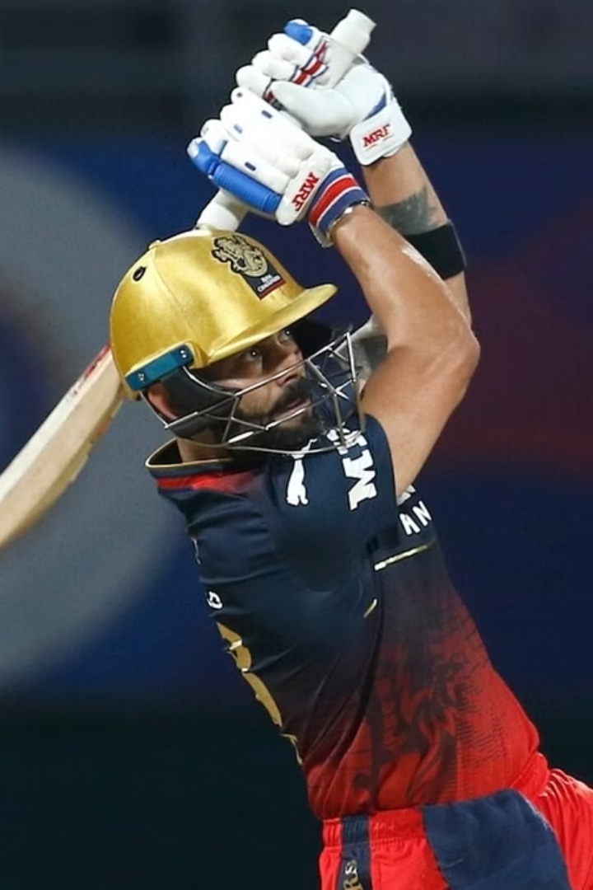
Data Preprocessing
Conducted an in-depth analysis to calculate key performance indicators for both batsmen and bowlers.
Data collected from website cricsheet.org in JSON format.
Convert JSON files into a CSV format and then combine all the match data into a single, comprehensive database with 243817 Rows and 17 Columns.
Match City, Date, Winner, bowler, overs, runs and Batsmen are few of the key columns.

Slide 7
Data Preprocessing
Runs Scored and Balls Faced: Aggregated the total runs scored and balls faced by each batsman.
Dismissals: Counted how many times each batsman got out to calculate their batting average.
Batting Average: Calculated as total runs scored divided by the number of times dismissed.
Strike Rate: Calculated as runs scored per 100 balls faced.

Slide 8
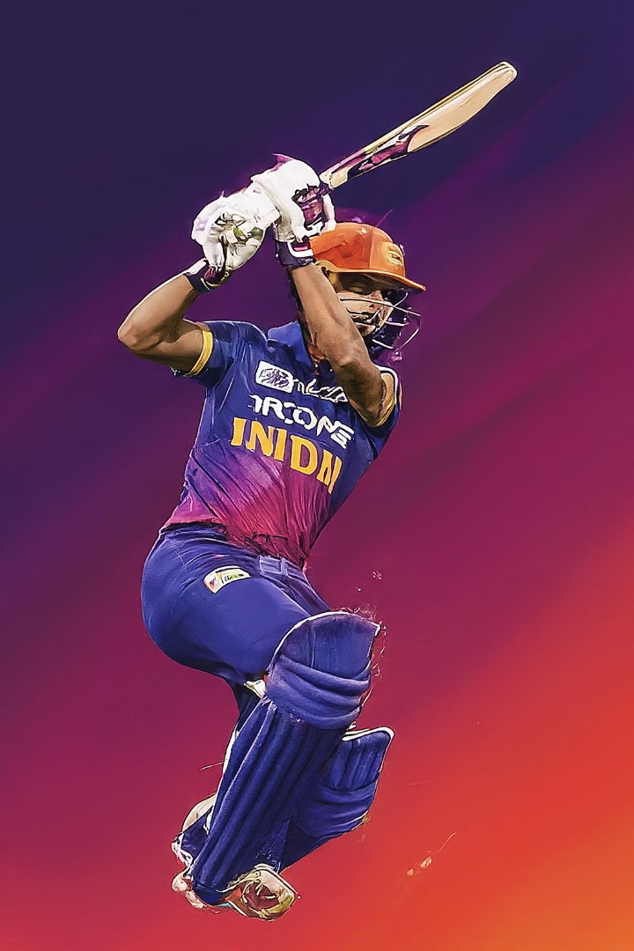
EDA
The team conducted an extensive Exploratory Data Analysis (EDA) to gain deeper insights into the IPL dataset. This involved analyzing various performance metrics for both batsmen and bowlers, as well as uncovering trends and patterns within the data.

Slide 9
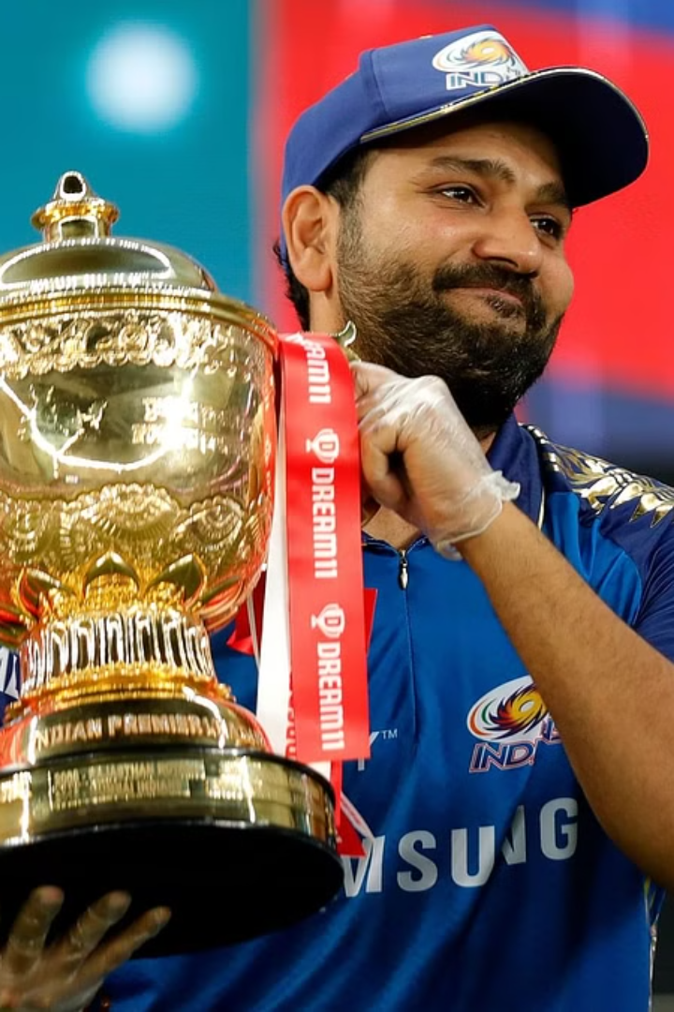
Exploratory Data Analysis
Our team conducted a comprehensive Exploratory Data Analysis (EDA) on the IPL dataset to uncover valuable insights and patterns that would inform our subsequent machine learning modeling efforts. We examined various aspects of the data, including player performance metrics, team dynamics, and match outcomes, to gain a deeper understanding of the factors that contribute to success in the IPL.

Slide 10
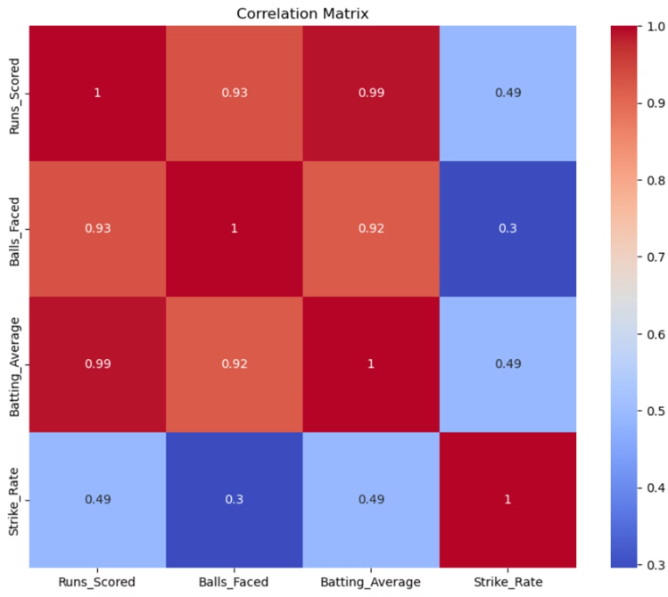
Correlation Plot

Slide 11
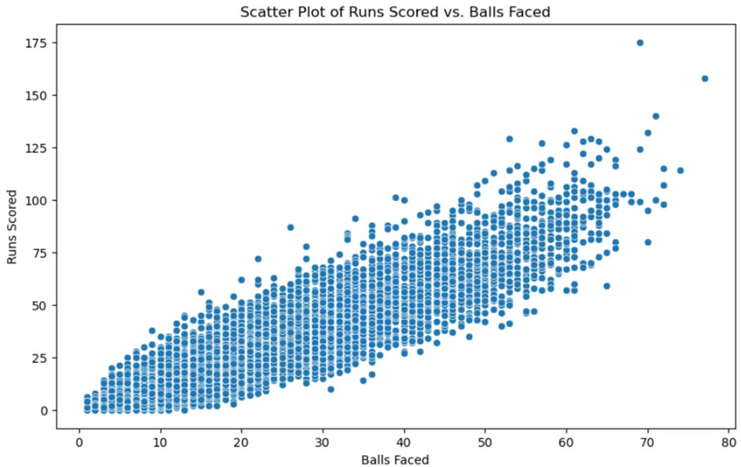
Scatter Plot of Run Scored

Slide 12
Machine Learning Models

Slide 13
Model to predict Runs Scored using the
Categorical Variables
We have categorical variables in our dataset.
Venue: Used one hot encoding
Team: Used one hot encoding
Opposing Team: Used one hot encoding
Batsmen: Used Label encoding

Slide 14
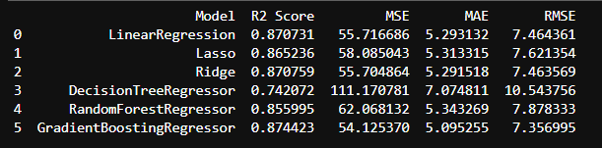
Models

Slide 15
TARGET VARIABLE
Batting Performance Impact: Batting Strike Rate Benchmark : 130 runs per 100 balls Batting Average Benchmark : 30 runs per dismissal
Performance Benchmark : 130 (SR) + 30 (Average) = 160
Quality = (Strike Rate + Average) / Performance Benchmark
Frequency = Balls Faced / Match
Player Impact = Quality x Frequency
100Factor = 100s scored / matches played
50 Factor = 50s scored / matches played
Batting Impact = Player Impact + (Player Impact x 100Factor) + (Player Impact x 50Factor/2)

Slide 16
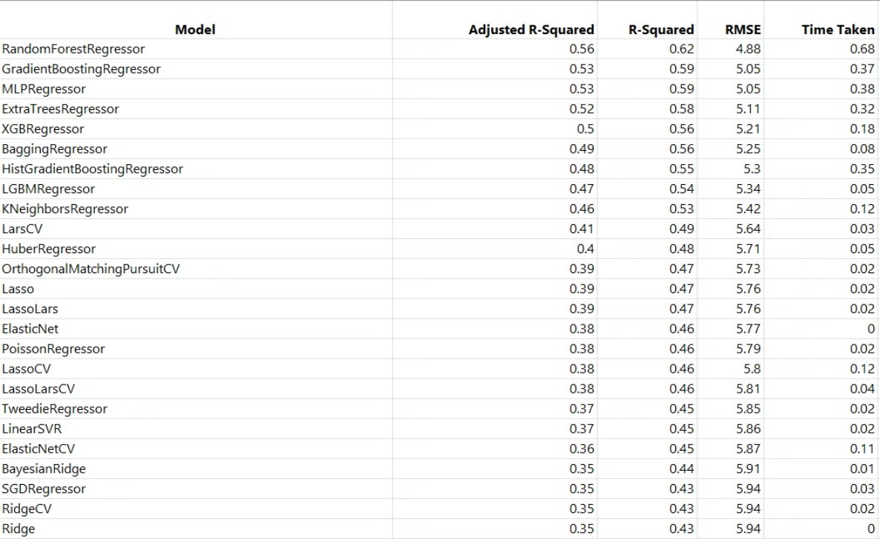
Lazy Predict

Slide 17
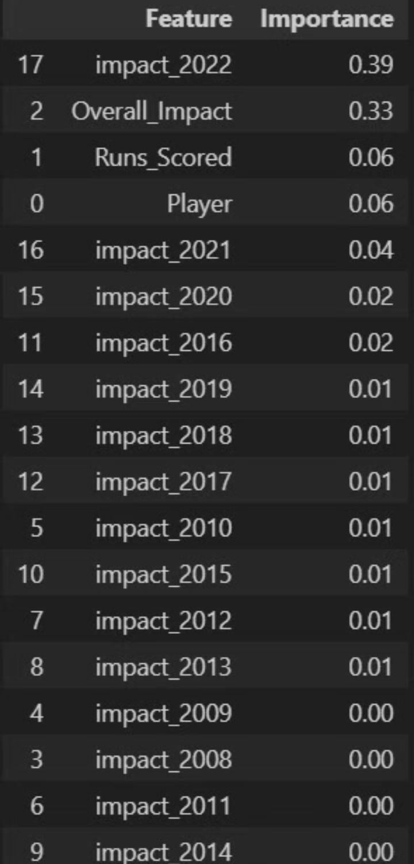
Feature Importance
In importance ranking, the most influential feature is "impact_2022" at 0.39, followed closely by "Overall_Impact" at 0.33. "Runs_Scored" holds relevance with an importance value of 0.06, while "impact_2021" is slightly less significant at 0.04. Previous years' impacts (2019 to 2008) have minimal importance, ranging from 0.01 to 0.00, highlighting the focus on recent performance metrics in assessing player impact.

Slide 18
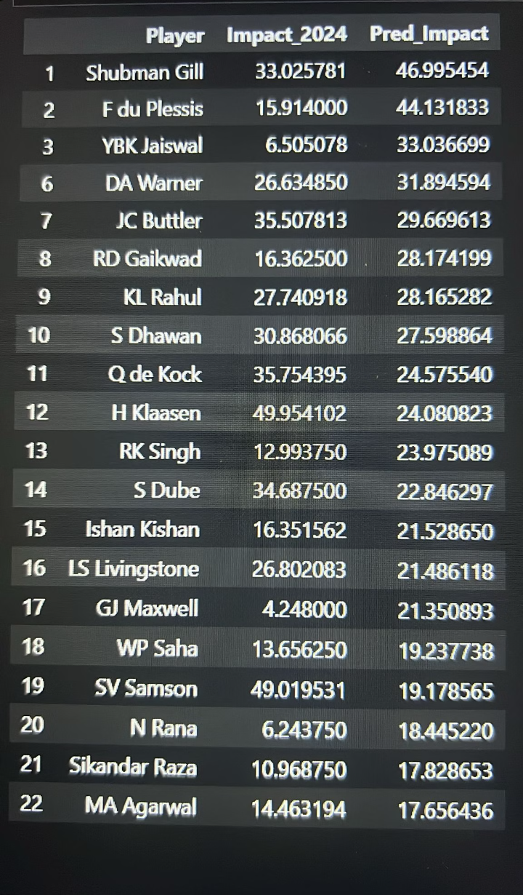
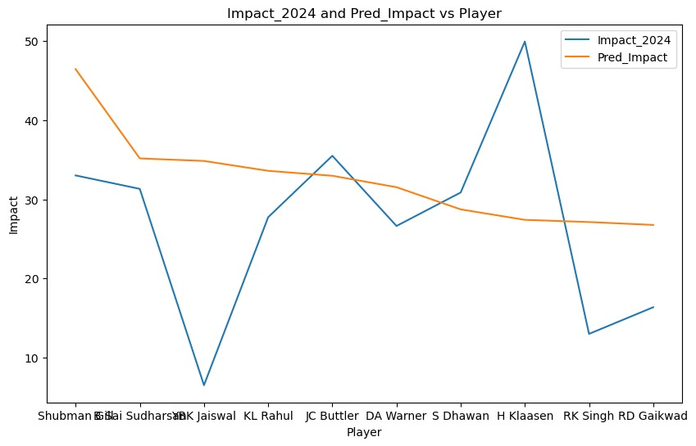
Random Forest Prediction
In 2024, standout players like Shubman Gill (Impact: 33.03), H Klaasen (Impact: 49.95), and SV Samson (Impact: 49.02) made significant impacts, surpassing predicted values, showcasing their prowess in cricket. Conversely, established players such as F du Plessis and YBK Jaiswal demonstrated notable impacts below predictions, suggesting varied performance dynamics within the sport.

Slide 19
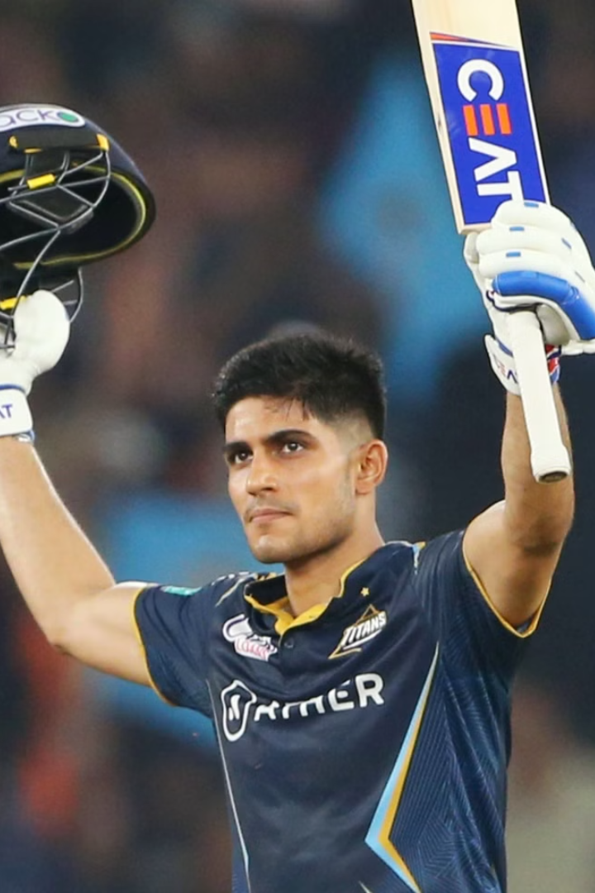
Conclusion
In conclusion, considering the significant impact Shubman Gill has made in 2024 (33.03) alongside the importance rankings of key performance metrics such as "impact_2022" (0.39) and "Overall_Impact" (0.33), coupled with the consistent performance predicted by lazy predict, Gill emerges as a potential asset for companies seeking brand promotion, aligning well with the established metrics and demonstrating promise for continued success

Slide 20
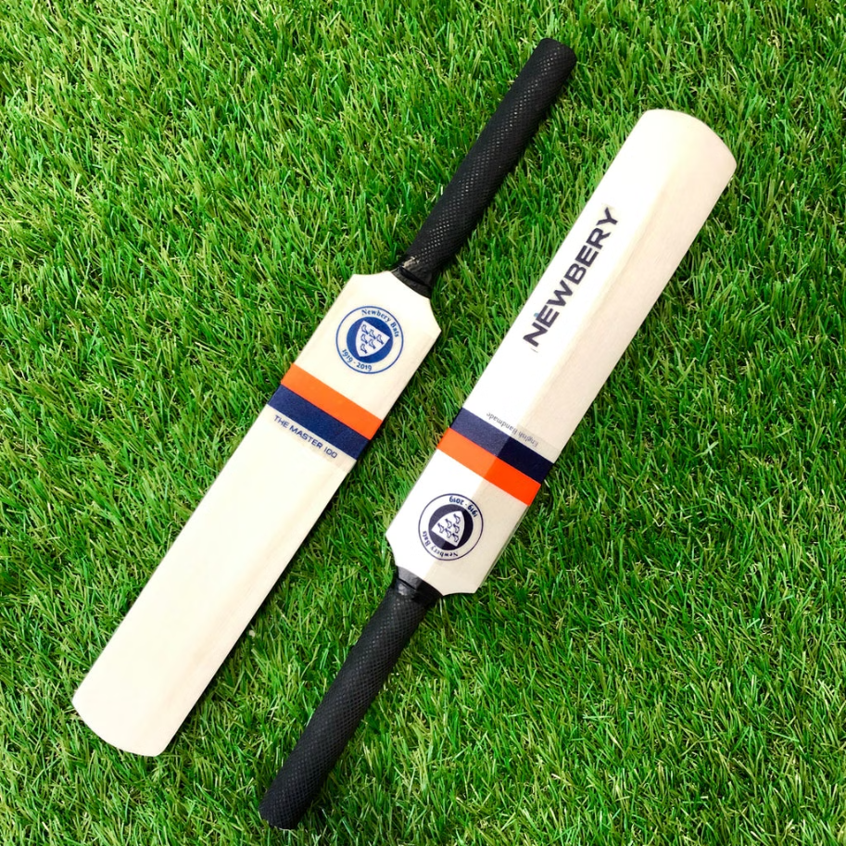

Thank you

